Slide 1
SPMP TG Meeting
01/31/2023

Slide 2
Agenda
Disclosures
Ratification Plan Sync/Update (2023)
S-Mode PMP Ratification Plan
Specification review and update (Bicheng)

Slide 3

Disclaimers
https://drive.google.com/file/d/1y_XWJus8M5ZwSQ2cvEOzCjlOmsmXOnN4/view?usp=sharing

Slide 4
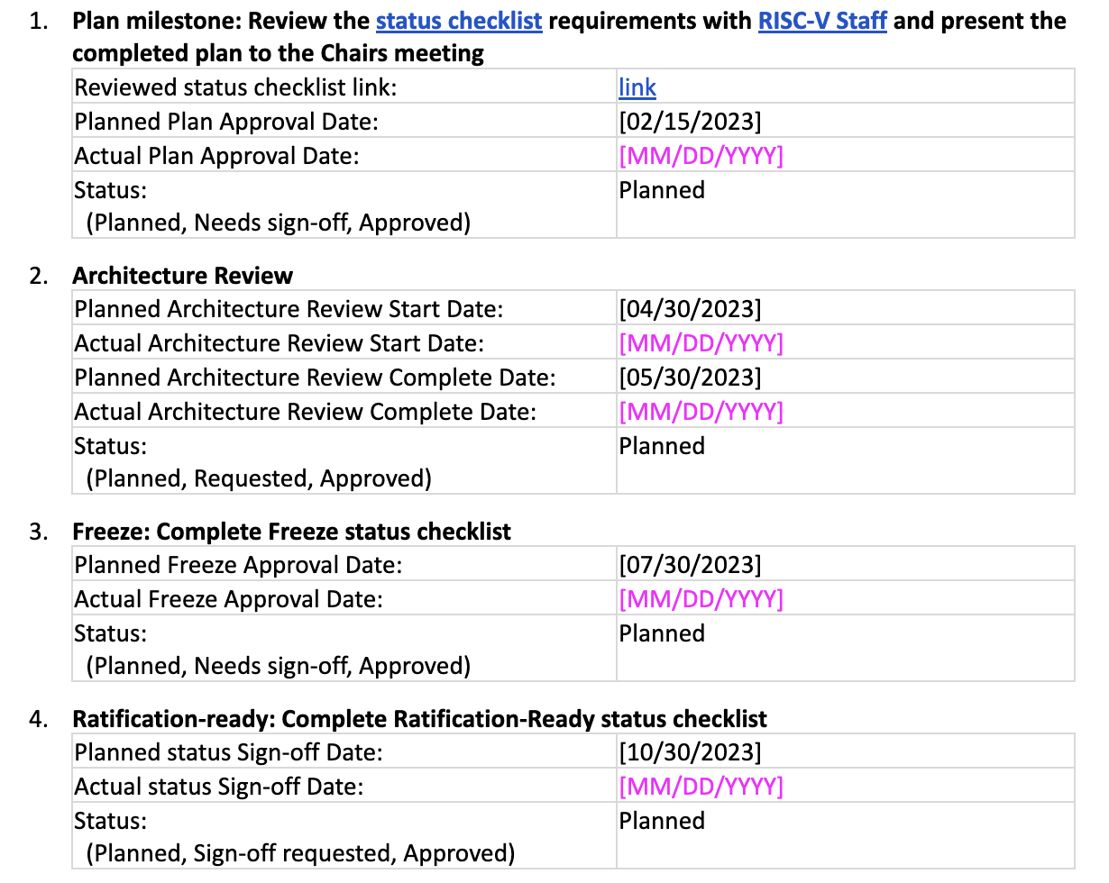
Ratification Plan Sync/Update (2023)
Please check the ratification plan for more details: https://docs.google.com/document/d/1lcF4uObpeYDWNuY2xSuGEQkBDguEFTaJsZKoQ2J0WTg

Slide 5
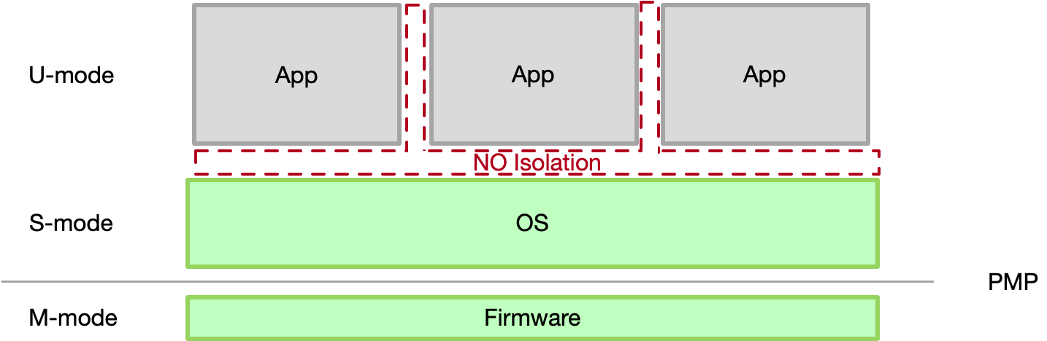
Specification review
Motivation: Supporting secure processing and enabling S-mode OS to limit the physical addresses accessible by U-mode software on low-end systems like internet of things (IoT).
It is hard to isolate the S-mode OSes (e.g., RTOS) and user-mode applications
Latest version: https://github.com/riscv/riscv-spmp/blob/main/rv-spmp-spec.pdf

Slide 6
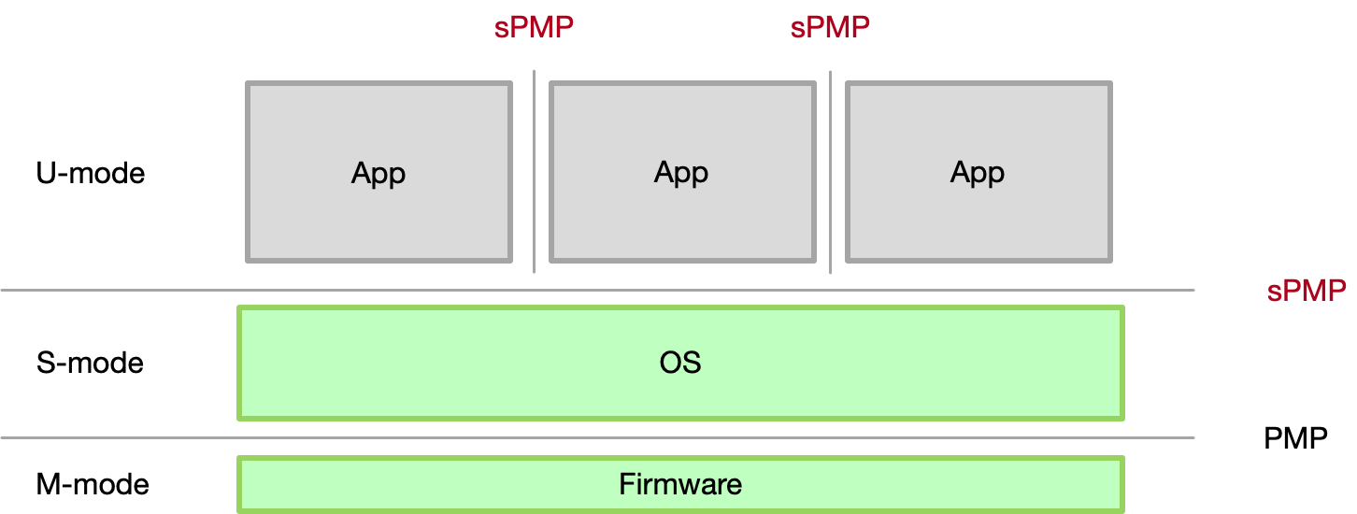
Specification review
sPMP is managed by S-mode, enable the isolation capability of S-mode software
OS running in S-mode
Isolate S-mode and M-mode via PMP
Isolate S/U and U/U via sPMP
OS can manage S/U and U/U isolation directly
PMP
w/ sPMP

Slide 7
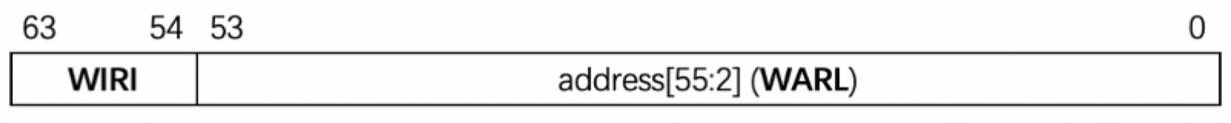
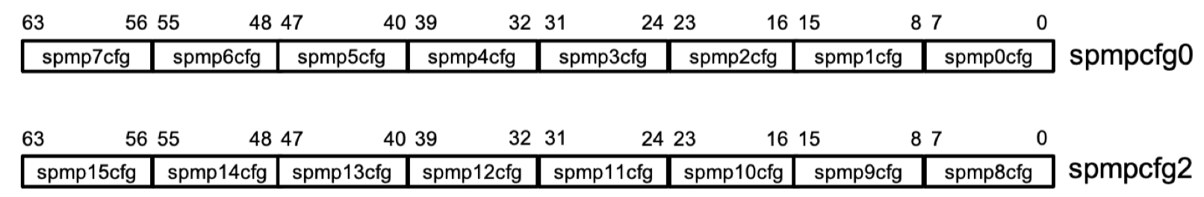
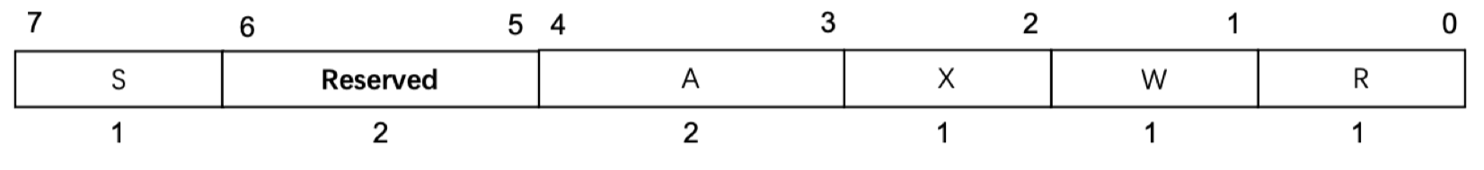
sPMP CSRs: spmpcfg and spmpaddr
spmpaddr: RV64 sPMP address register format
spmpcfg: RV64 sPMP configuration CSR layout
spmp[i]cfg: format of each sPMP entry
Notes:
The encoding of sPMP resembles which of ePMP (except SPMP doesn’t use locked rules).
The S bit marks a rule as S-mode-only when set and U-mode-only when unset.
The encoding of spmpcfg.RW=01, and the encoding spmpcfg.SRWX=1111, now encode a Shared-Region.
Bit 5 and 6 are reserved for future use.
The A bit will be described in the following sections (2.3).
The R/W/X bits control read, write, and instruction execution permissions.

Slide 8
Priority and Matching Logic
The A field in an sPMP entry’s configuration register (spmpcfg.A) encodes the address-matching mode of the associated sPMP address register (spmpaddr) — The same as PMP/ePMP.
If the privilege mode of the access is M-mode
The access is allowed
If the privilege mode is S-mode and no SPMP entry matches
The access is allowed
If the privilege mode is U-mode and no SPMP entry matches, but at least one SPMP entry is implemented
The access fails
Otherwise
The access is checked according to the permission bits in the matching SPMP entry
Allowed only if it satisfies the permission checking with the SRWX bits corresponding to the access type

Slide 9
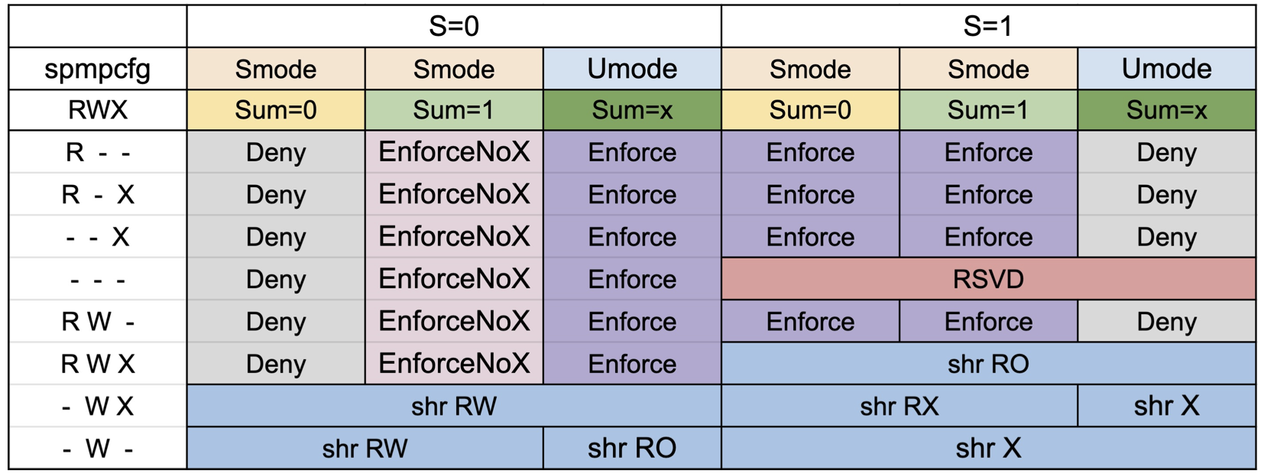
The permission encoding of sPMP
Flexible privilege management, consistent with ePMP’s encoding
S/U region
SMAP (Supervisor Mode Access Prevention)
SMEP (Supervisor Mode Execution Prevention)
Shared region
Notes:
SPMP has three kinds of rules: U-mode-only, S-mode-only, and Shared-Region rules.
The S bit marks a rule as S-mode-only when set and U-mode-only when unset.
The encoding spmpcfg.RW=01 encodes a Shared-Region and spmpcfg.SRWX=1000 is reserved for future standard use.
An S-mode-only rule is enforced on Supervisor mode and denied on User mode.
A U-mode-only rule is enforced on User modes and denied/enforced on Supervisor mode depending on the value of sstatus.SUM bit:
If sstatus.SUM is set, a U-mode-only rule is enforced yet without code execution permission on Supervisor mode in order to ensure SMEP.
If sstatus.SUM is unset, a U-mode-only rule is denied on Supervisor mode.
A Shared-Region rule is enforced on both Supervisor and User modes, with restrictions depending on the spmpcfg.S and spmpcfg.X bits:
If spmpcfg.S is not set the region can be used for sharing data between S-mode and U-mode so is not executable. S-mode has RW access to that region and U-mode has read-only access if spmpcfg.X is not set, or RW access if spmpcfg.X is set.
If spmpcfg.S is set the region can be used for sharing code between S-mode and U-mode so is not writeable. Both S-mode and U-mode have execute access on the region and S-mode may also have read access if spmpcfg.X is set.
The encoding spmpcfg.SRWX=1111 can be used for sharing data between S-mode and U mode, where both modes only have read-only access to the region.

Slide 10
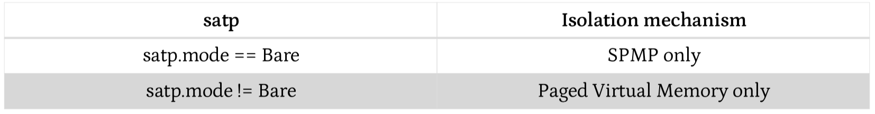
sPMP and Paging
sPMP is enabled when satp.mode==Bare and sPMP is implemented
Enable both paging and sPMP will introduce one more layer to check permission for each memory access. This issue will be more serious for guest OS which may have host sPMP and guest sPMP.
MMU can provide sufficient protection.
Notes:
We do not allow both SPMP and MMU permissions active at the same time now because:
It will introduce one more layer to check permission for each memory access. This issue will be more serious for guest OS which may have host SPMP and guest SPMP.
paged virtual memory can provide sufficient protection.

Slide 11
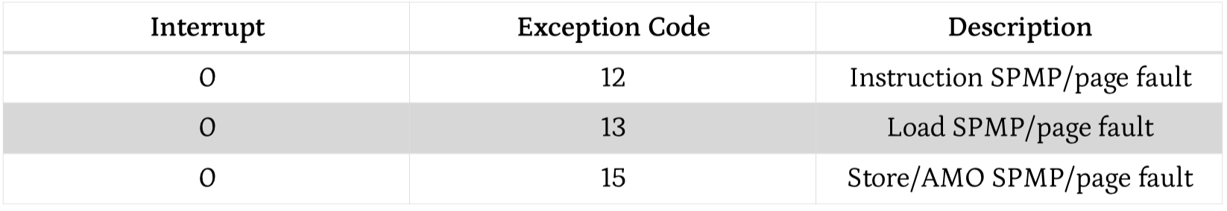
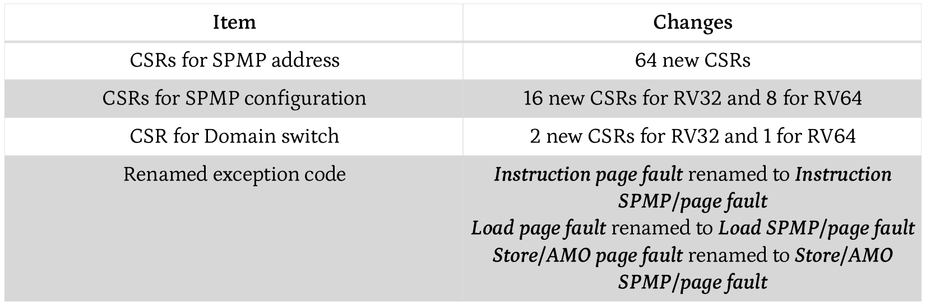
Summary of Exceptions & Hardware Changes
Exceptions:
Hardware changes:
Notes:
The SPMP reuses exception codes of page fault for SPMP fault.
This is because page fault is typically delegated to S-mode, and so does SPMP, so we can benefit from reusing page fault.
S-mode software(i.e., OS) can distinguish page fault from SPMP fault by checking satp.mode. (SPMP and paged virtual memory will not be activated simultaneously)
The SPMP is proposing to rename page fault to SPMP/page fault for clarity.

Slide 12
Optimization: Context Switching (optional)
Optimization:
For small devices with very limited resources, treat sPMP entries as global and use one spmpswitch CSR to manage sPMP status.
Context Switching Optimization:
Add CSR called spmpswitch
Each bit of spmpswitch holds on/off status of the corresponding sPMP entry.
During context switch, the OS can simply save and restore spmpswitch as part of the context
An sPMP entry is activated only when both corresponding bits in spmpswitch and A field of spmpcfg are set. (i.e., spmpswitch[i] & spmp[i]cfg.A)
RV64 sPMP domain switch register format:
Notes:
With SPMP, each context switch requires the OS to store 64 address registers and 8 configuration registers (RV64), which is costly and unnecessary.
So the SPMP is proposing an optimization to minimize the overhead caused by context switching.
Each bit of spmpswitch register holds on/off status of the corresponding SPMP entry respectively.
During context switch, the OS can simply store and restore spmpswitch as part of the context.
An SPMP entry is activated only when both corresponding bits in spmpswitch and A field of spmpicfg are set. (i.e., spmpswitch[i] & spmp[i]cfg.A)

Slide 13
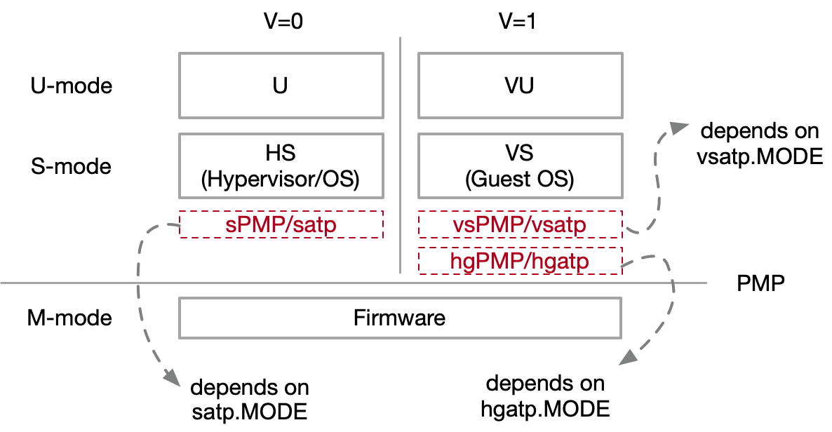
Interaction with hypervisor extension
vSPMP extension
64 vSPMP address registers and 16 configuration registers.
For HLV, HLVX, and HSV instructions, the hardware should perform vSPMP checking before G-stage address translation
The vSPMP checking is performed in the guest physical addresses, before G-stage address translation.
hgPMP extension
64 address registers and 16 configuration registers.
All guest memory accesses will be checked by hgPMP; while hypervisor (in HS mode) and HU mode applications will not be affected.
When V=1, and hgatp.MODE=Bare, hgPMP is used to provide isolation between hypervisor and guest VMs.
The hgPMP checking is performed after the guest address translation (or vSPMP checking), before PMP checking.

Slide 14
Thanks!

Slide 15
Overall status
Hardware PoC
Qemu support is released now
https://github.com/ybc-alkaid/qemu
Done: smpucfg/smpuaddr, basic tests
smpuswitch/vSMPU/hgMPU are not supported now
Nuclei: N308 board
Software PoC
RTOS/Linux: WiP with partners
Hypervisor
Spec: needs more discussion

